Slide 1
Open Networks
annual flexibility consultation
24 August 2022

Slide 2
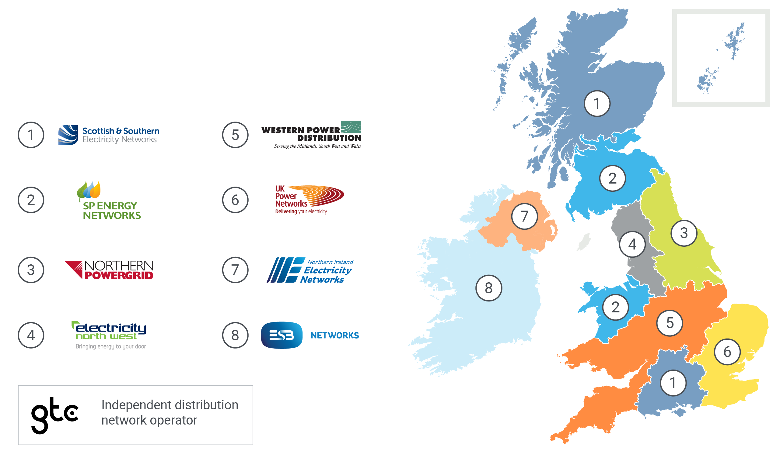
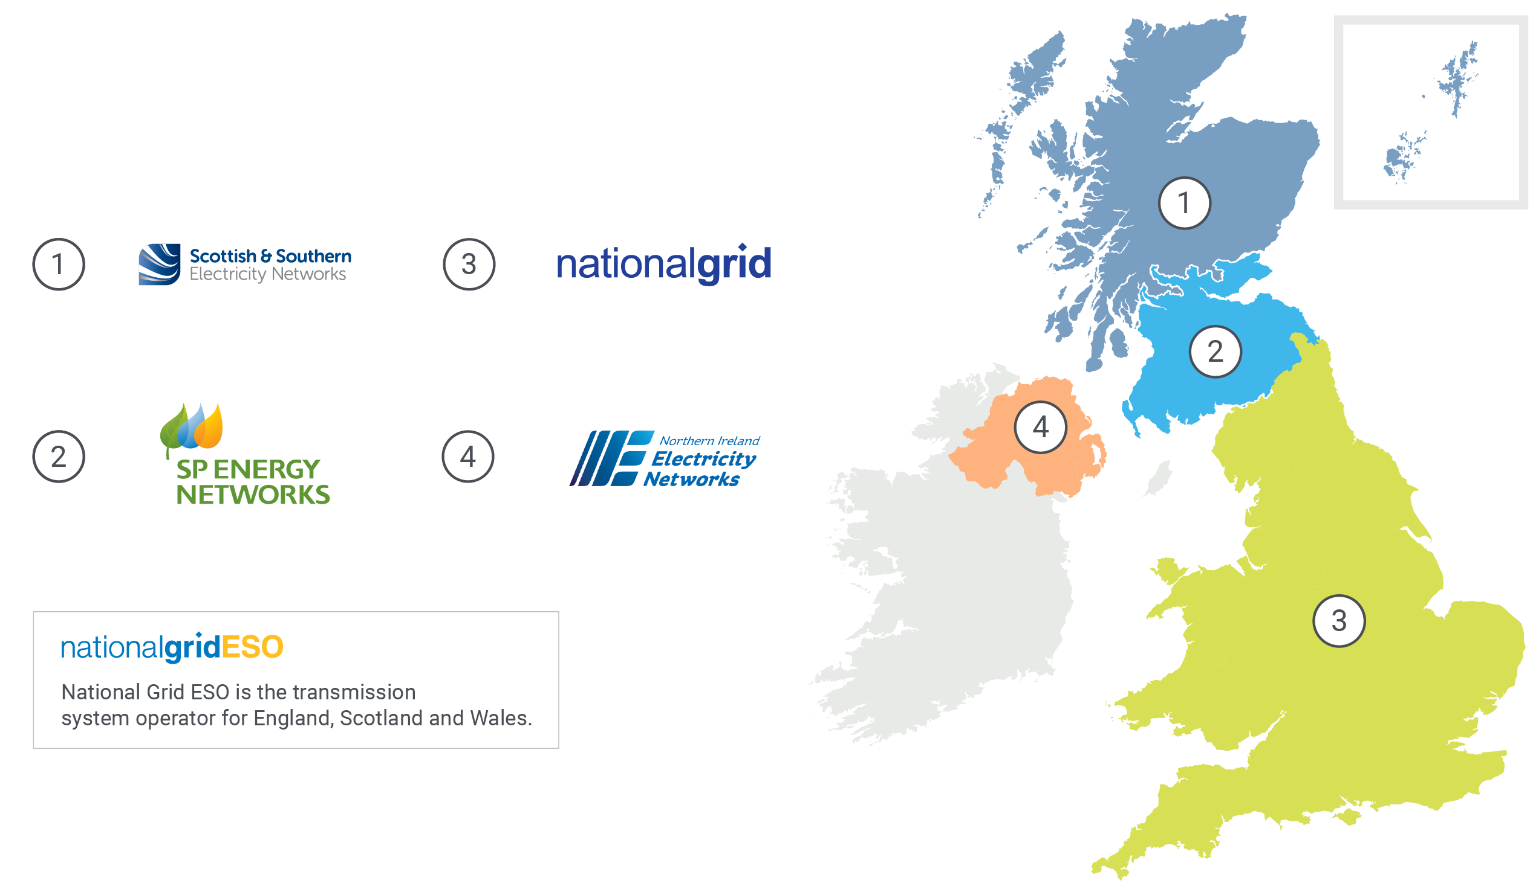
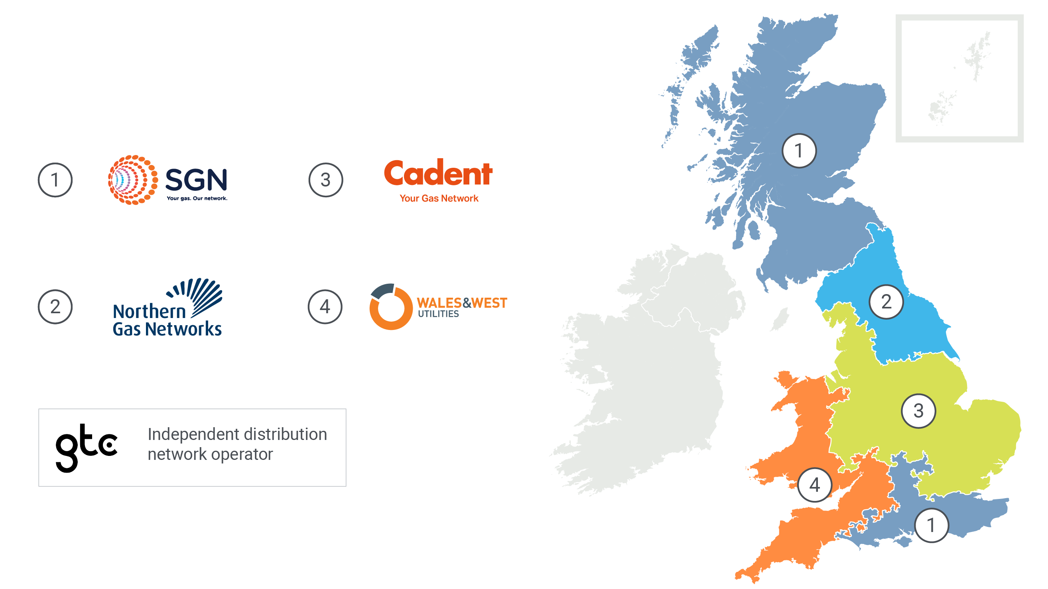
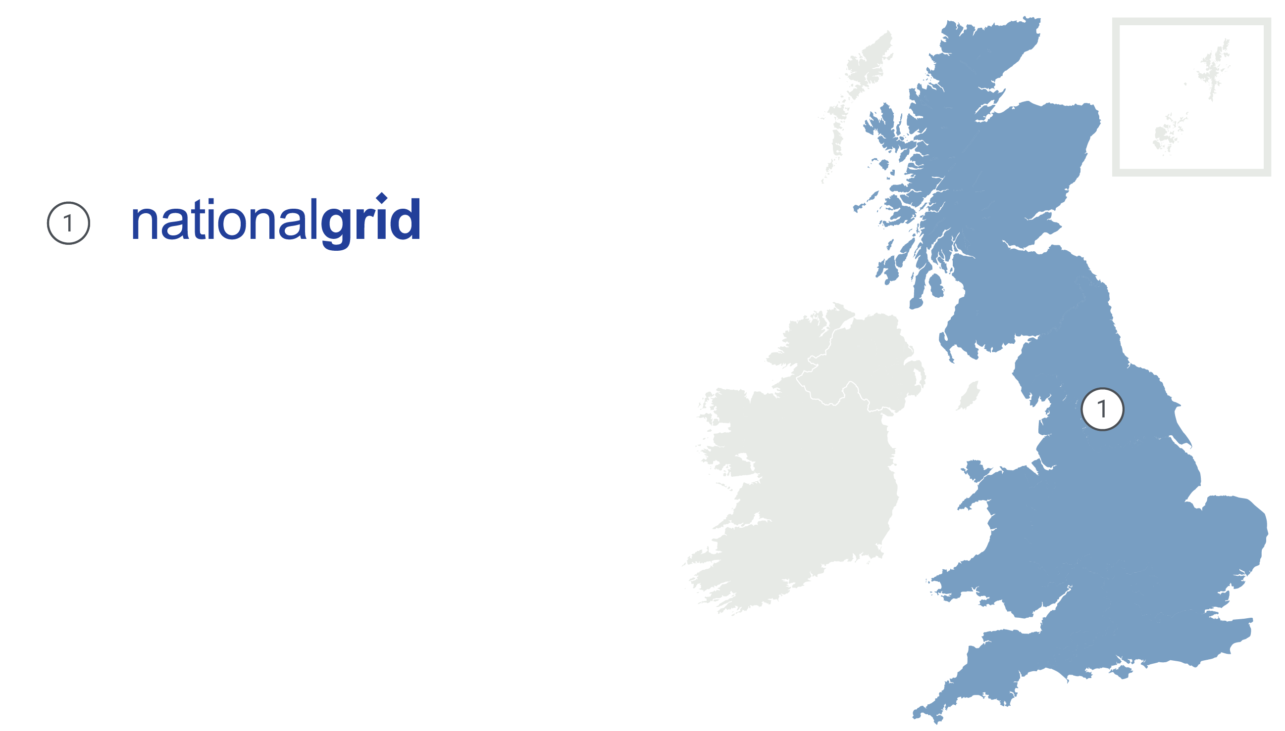
Introduction to ENA
The voice of the networks
29 million electricity customers
21.5 million gas customers
180,000 miles of gas network
519,304 miles of electricity network
£60bn invested 2015-23

Slide 3
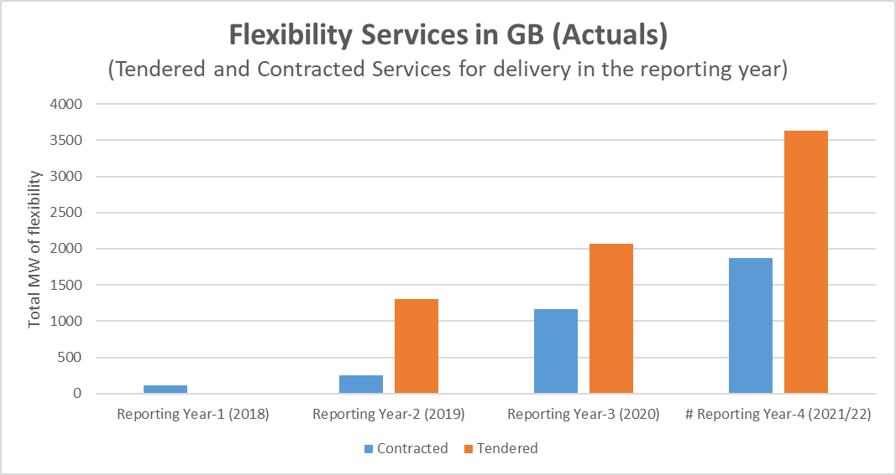
Introduction to Open Networks
Now in it’s fifth year, the Open Networks programme is a major industry programme working with all GB energy networks and industry to lead the transition to a smart and flexible energy system that will enable net zero. The programme has been recognised in the Smart Systems and Flexibility Plan and drives significant change across the country, notably in 2022 we’ve:
Facilitated significant growth in flexibility
World leading with a record levels, with 3.7GW of flexibility tendered 2021/22, of which nearly 2GW were contracted.
Improved accuracy for Flex Service Providers
Delivered a Baselining Tool to help FSPs to follow a common approach to measure flexibility delivered.

Slide 4
Annual Flexibility Consultation
The purpose of this consultation is to seek views from stakeholders on our flexibility developments to date and planned future developments, informing and steering our work accordingly. Therefore, the questions in this consultation are structured to:
encourage as many stakeholders as possible, from a wide variety of viewpoints, to engage with our development work on flexibility;
provide feedback on the content of our work to date;
and help inform and shape the future work to be undertaken by ENA and the Open Networks programme.
This consultation is an opportunity to influence the direction of travel of a key part of the energy system and ensure your voice is heard. Everyone is welcome to respond, and there will be plenty of opportunities during the webinar today to ask questions.

Slide 5
Click to access documents below
Flexibility Consultation Wrapper
Overview and summary
Overarching Common Framework and Strategic Roadmap for Flexibility Early draft of framework and roadmap (P0)
Needs identification/Pre-procurement
Procurement
Operations & Settlement
Pre-qualification process Recommendations for alignment
(P2)
Dispatch Interoperability Recommendations for alignment
(P3)
Common Evaluation Methodology*
(P1)
Real-time procurement Recommendations to move to real-time procurement
(P2)
Primacy Rules for Service Conflicts*
(P5)
Active power service definition Review of current use by DNOs and areas of divergence
(P6)
Standard agreement Recommendations to standardise contract schedules
(P4)
Baselining
Inviting general feedback on tool (2021 P7)
Reporting & information sharing
Carbon reporting Proposed methodology for reporting
(P7)
ANM Curtailment Information Common methodology for providing curtailment estimates
(P8)
* No deliverables seeking input as part of this consultation. Please see the relevant product section of the Flexibility Consultation Wrapper for full details.

Slide 6
Annual Flexibility Consultation – how to submit a response
The consultation closes on Monday 12 September 2022, and you can submit a response by emailing it to the Open Networks team at opennetworks@energynetworks.org
The consultation wrapper document can be found on the ENA website.
It is our intention to review the responses to this consultation and publish our comments on the feedback by the end of November 2022. This will be available on ENA’s website.

Slide 7
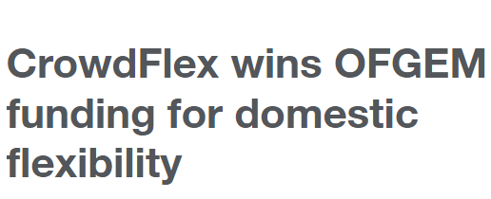
Case studies

Slide 8
Useful links
Join the Dissemination Forum
To help guide the work of the programme, a Dissemination Forum is run quarterly as an online event for anyone to join. It gives stakeholders the opportunity to engage broadly with Open Networks, stay up to date with the latest developments and to provide input into it.
Sign up to the Open Networks Newsletter at the bottom of the webpage to hear regular programme updates.
View the latest flexibility figures on the ENA website.

